Slide 1

SQL PROJECT
SOHINI SENGUPTA
ROLL – 50

Slide 2

INTRODUCTION
Forensic Investigations and Consultancy Services is an ISO 9001-2015 certified Forensic Investigative and Service Agency with its firm technological knowledge and experiences in several Forensic domains.

Slide 3

SERVICES PROVIDED IN DOMAINS - 1) Document Examination & Verification 2) Handwriting and Signature Verification 3) Background Verification Detective Services 4) Fingerprint Matching and Verification 5) Cyber Forensic 6) Mobile Forensic 7) Forensic Accounting for Corporates and Banks

Slide 4

DATA POINTS
CLIENT DATA
CASE DETAILS
INSTRUMENTS REQUIRED
EMPLOYEE DATA
DEPARTMENT
AWARDS
COURT REPORTINGS
SUPPLIER
FUNDS TRANSFER
EVENTS

Slide 5
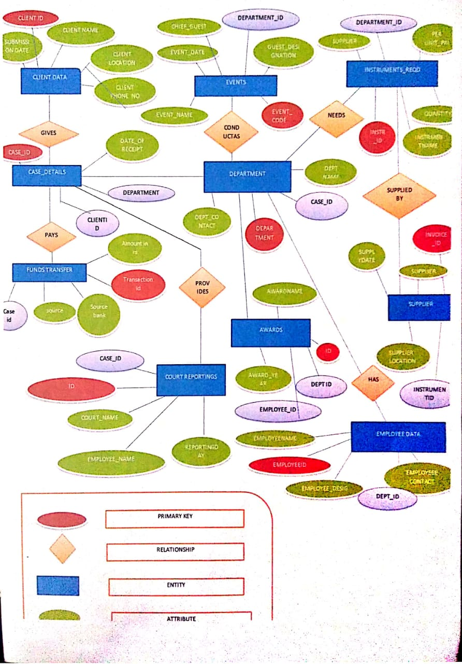
ER MODEL FOR FICS DATABASE

Slide 6
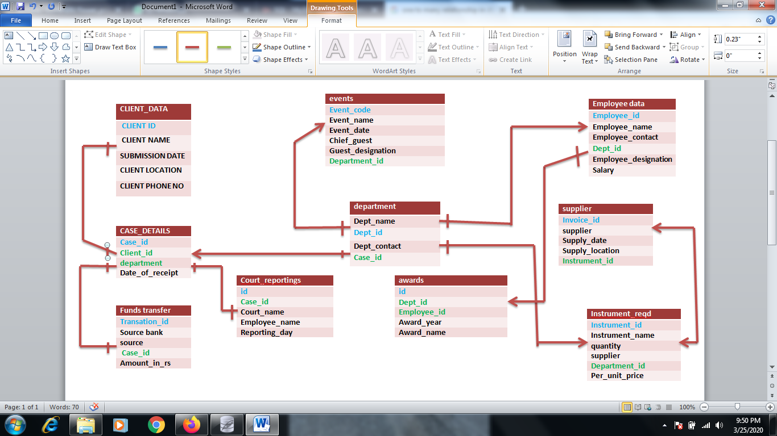
ER DIAGRAM

Slide 7
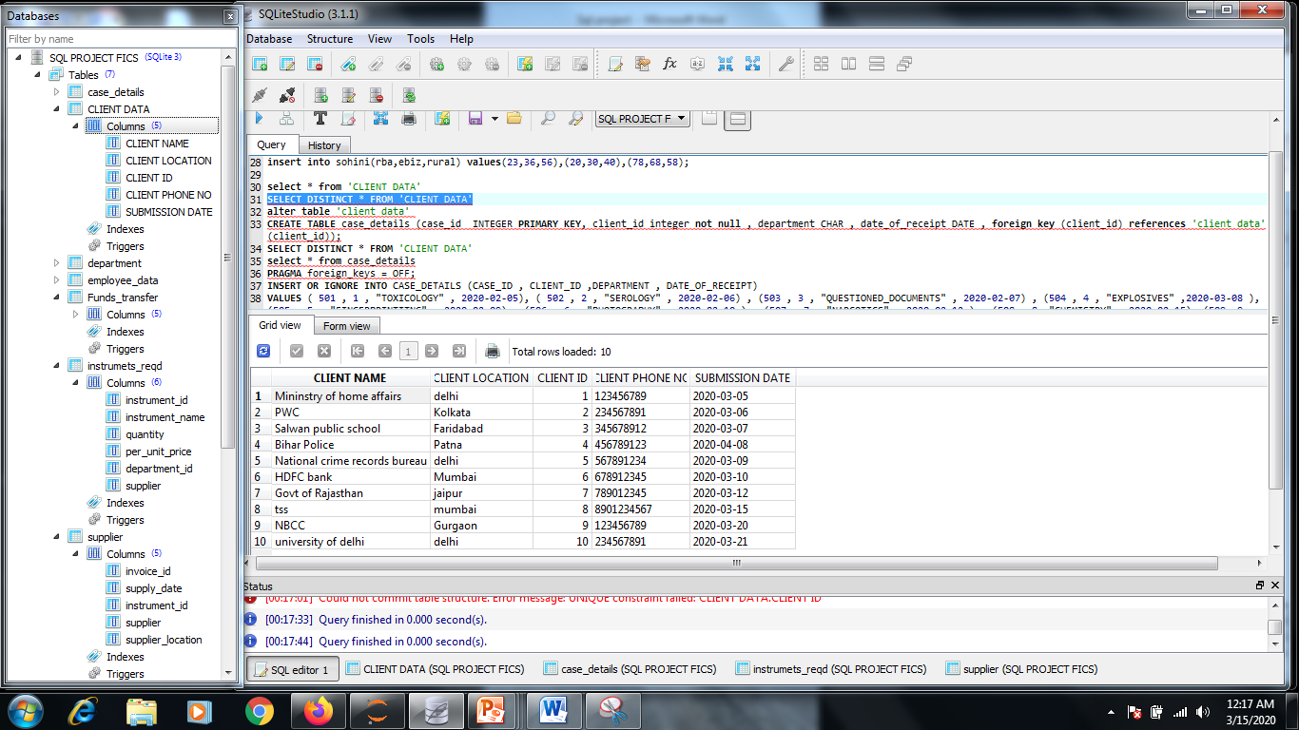
TABLE 1 – CLIENT DATA

Slide 8
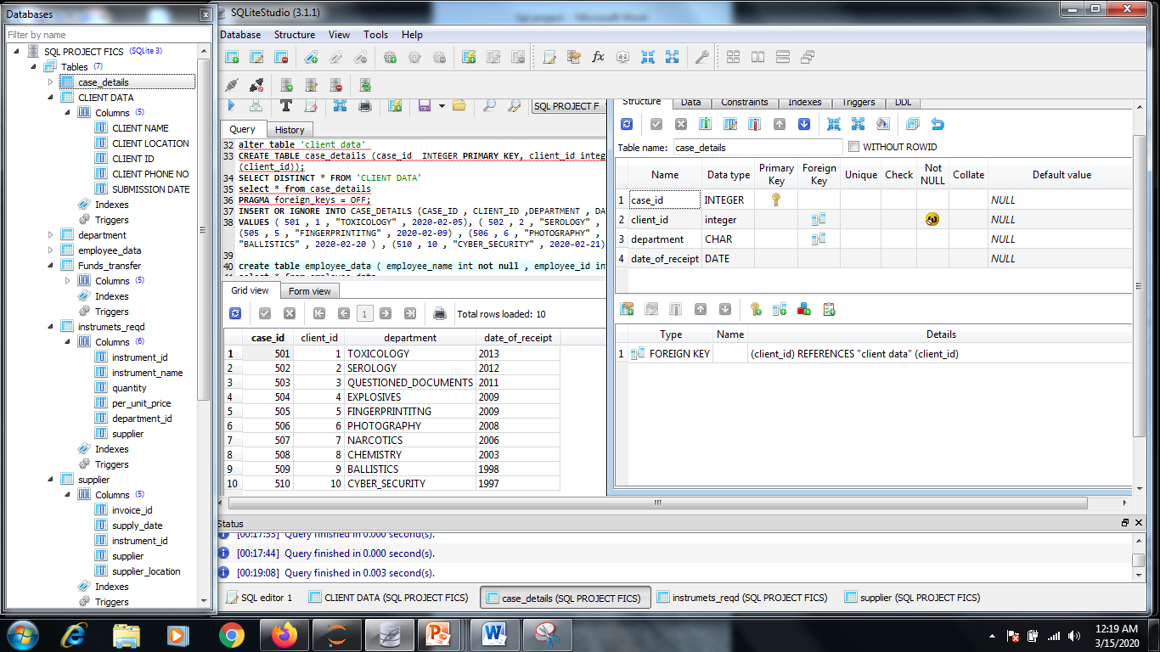
TABLE 2 – CASE DETAILS

Slide 9
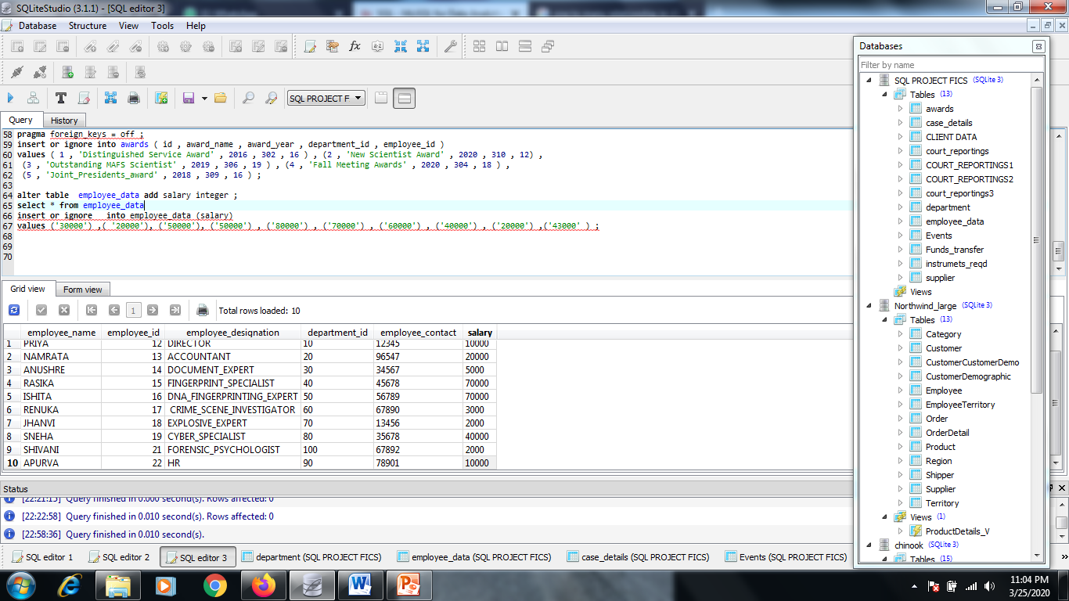
TABLE 3 – EMPLOYEE DATA

Slide 10
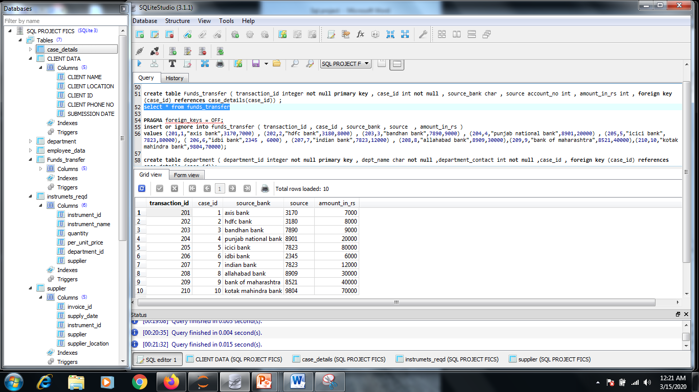
TABLE 4 – FUNDS TRANSFER

Slide 11
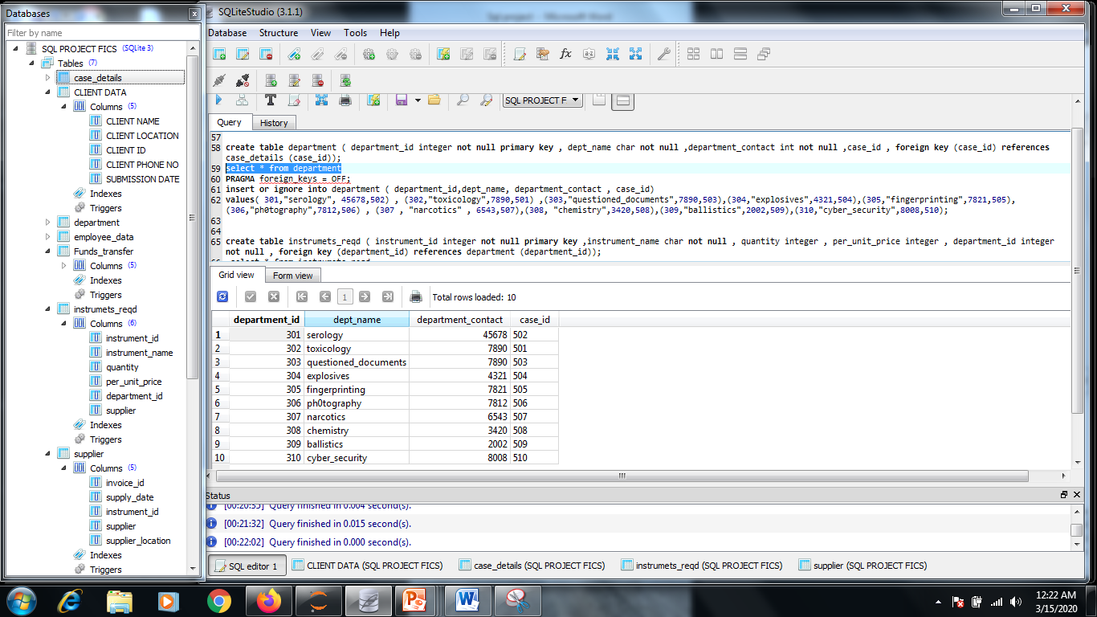
TABLE 5 – DEPARTMENT

Slide 12
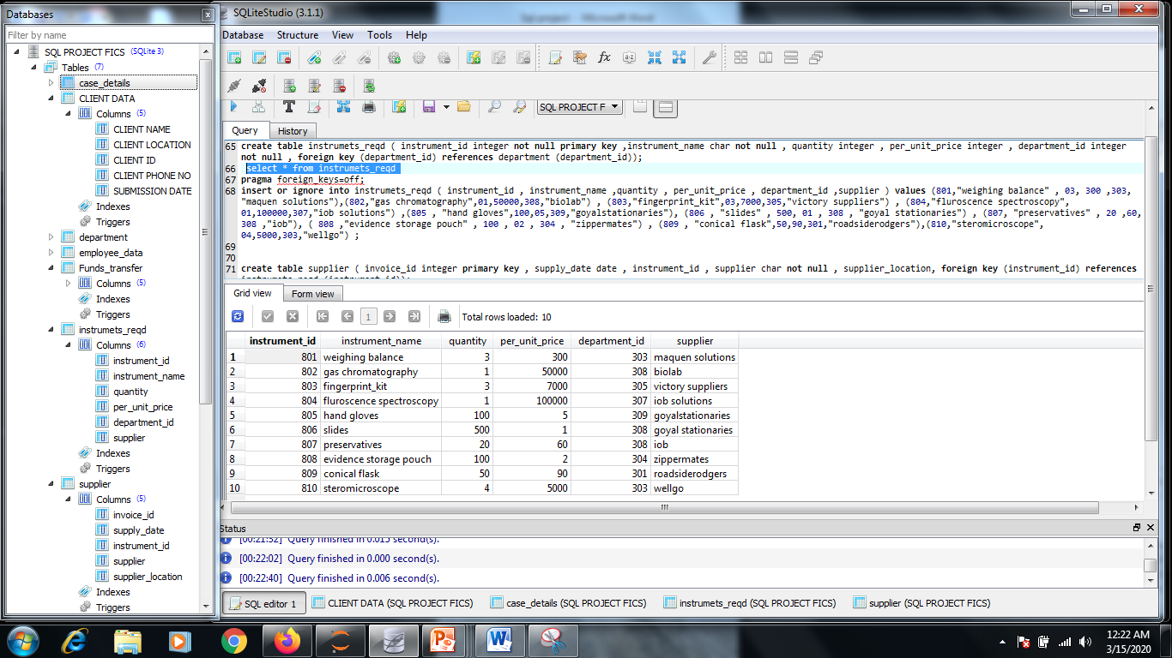
TABLE 6 – INSTRUMENTS_REQD

Slide 13
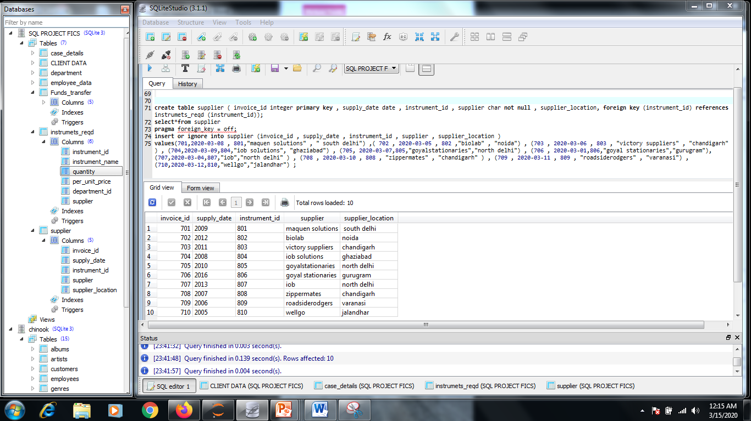
TABLE 7 – SUPPLIER

Slide 14
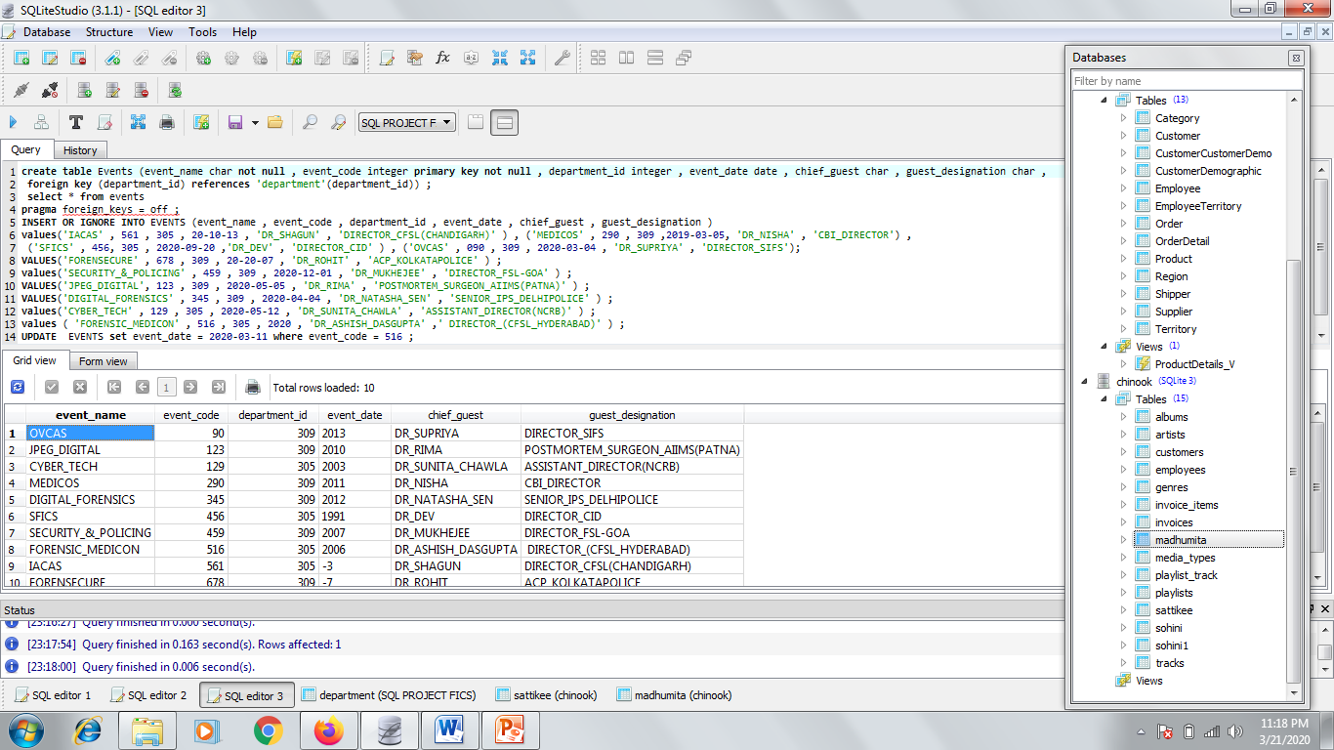
TABLE 8 – EVENTS

Slide 15
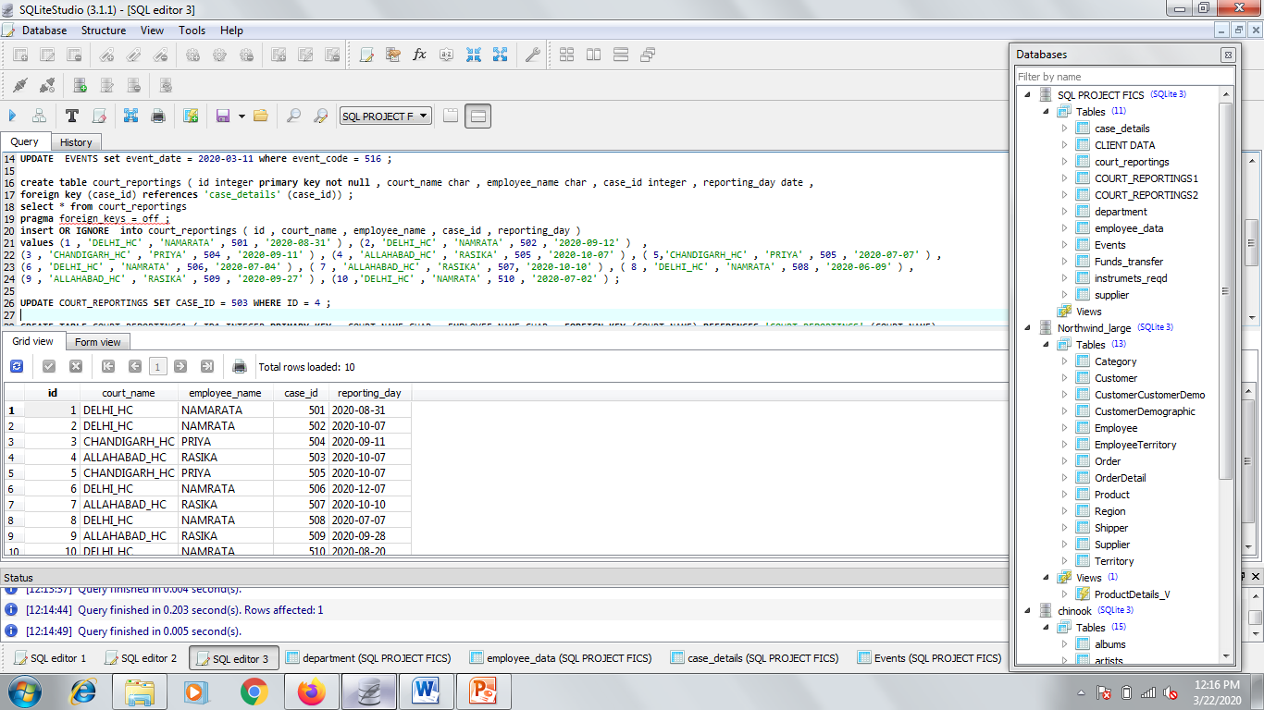
TABLE 9 – COURT REPORTINGS

Slide 16
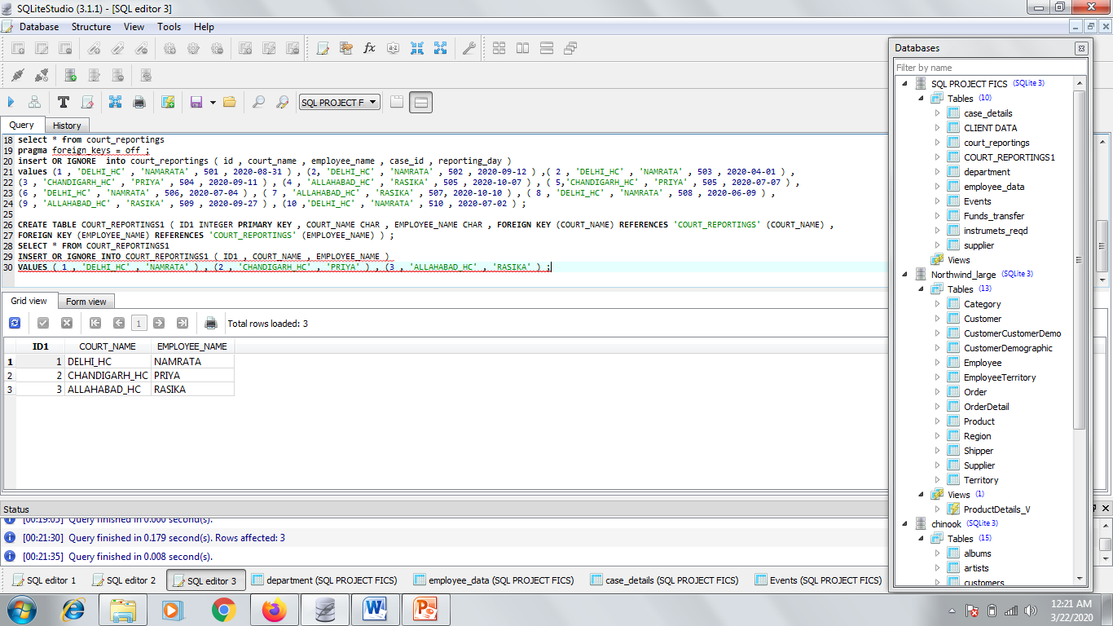
TABLE 9 AFTER NORMALIZATION (2NF)

Slide 17
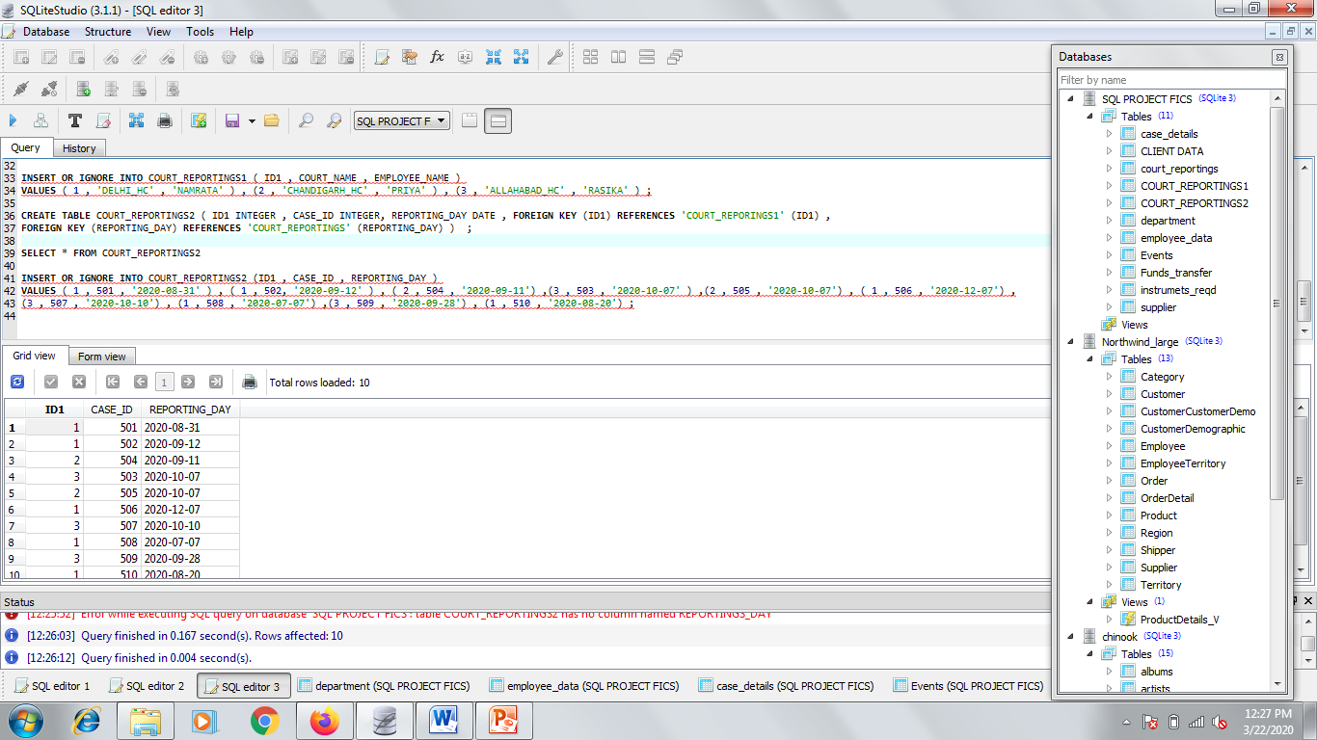
AFTER 2NF

Slide 18
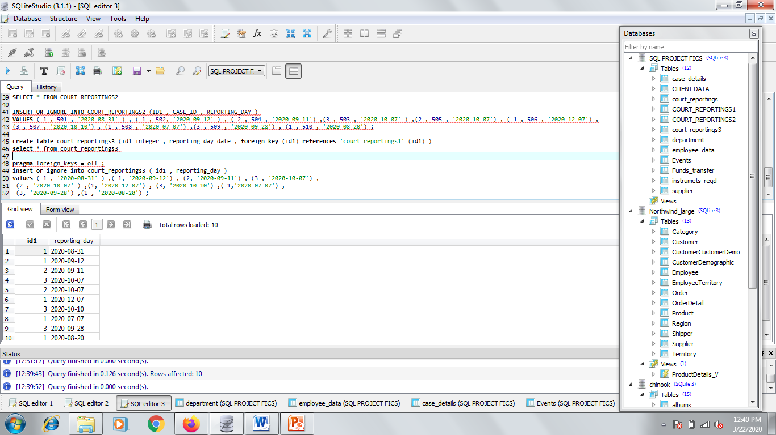
AFTER 3NF

Slide 19
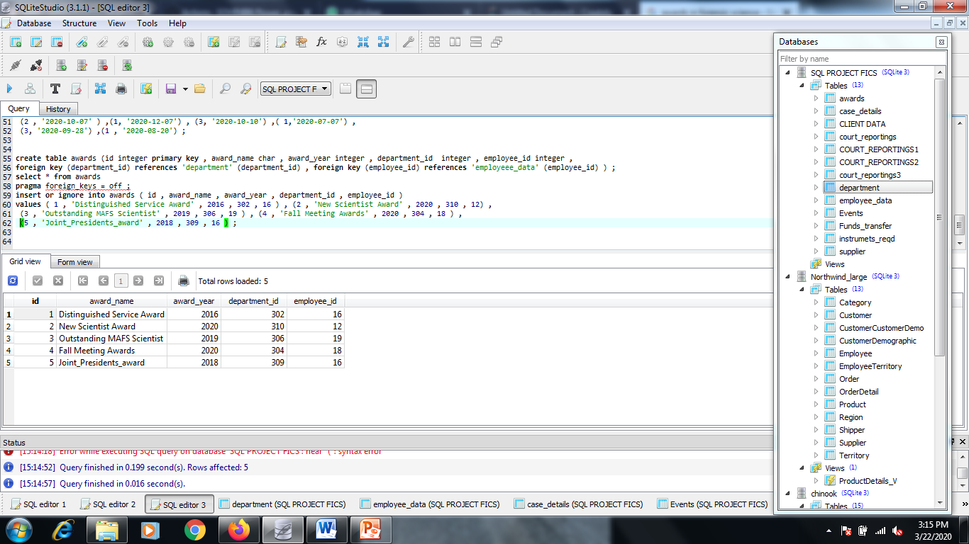
TABLE 10 – AWARDS

Slide 20
THANK YOU

